Slide 2
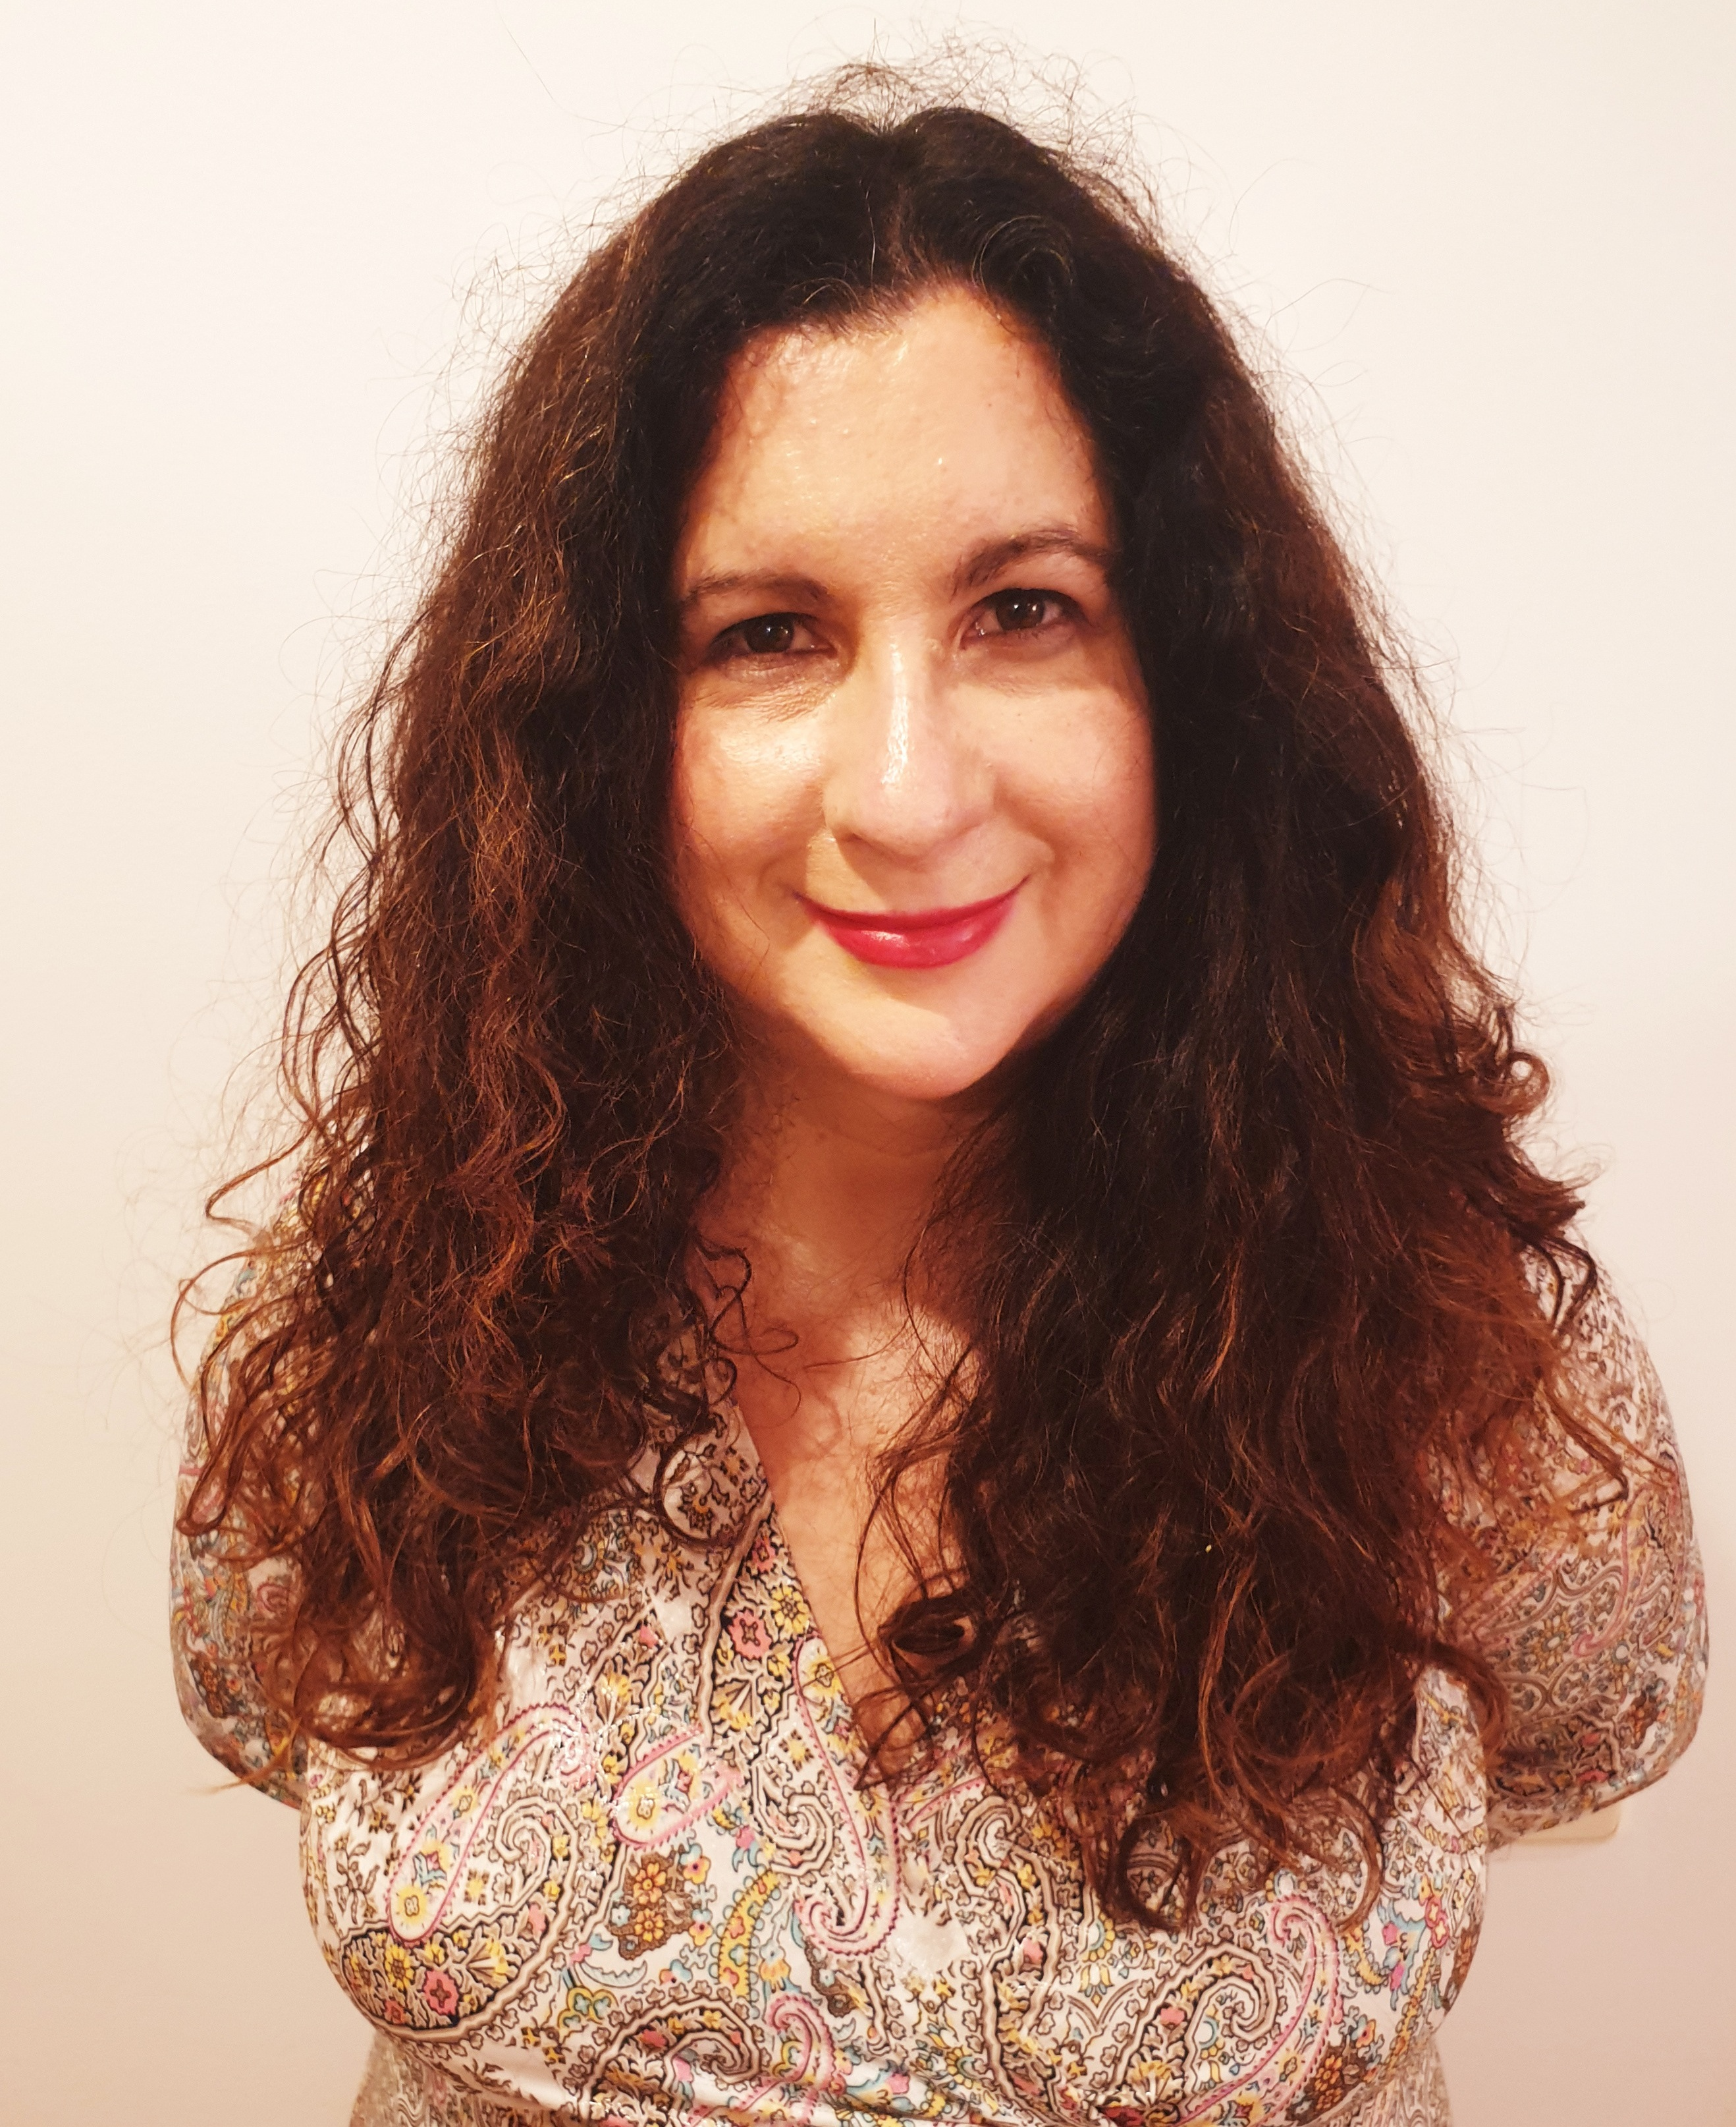
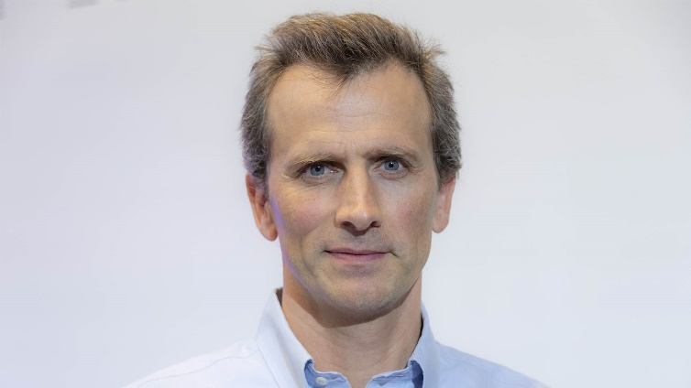
GSI'23 keynote speakers
Francis Bach
INRIA, France
Diara Fall
Orleans University, France
https://sites.google.com/site/mdiarrafall
Eva Miranda
UPC AND CRM-BARCELONA, spain
https://web.mat.upc.edu/eva.miranda/nova/

Slide 3
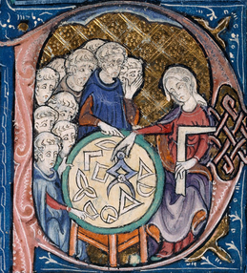
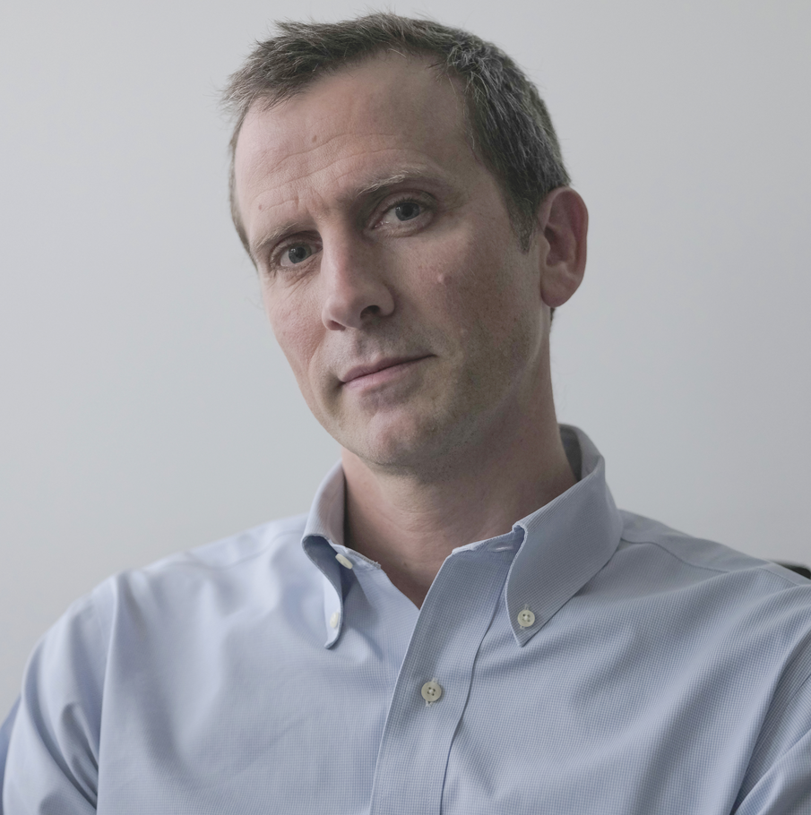
Geometric Science of Information (GSI'23) Saint-Malo, France, 30th Aug-1st Sept 2023 Keynote speaker: Francis BACH
Information Theory with Kernel Methods
Estimating and computing entropies of probability distributions are key computational tasks throughout data science. In many situations, the underlying distributions are only known through the expectation of some feature vectors, which has led to a series of works within kernel methods. In this talk, I will explore the particular situation where the feature vector is a rank-one positive definite matrix, and show how the associated expectations (a covariance matrix) can be used with information divergences from quantum information theory to draw direct links with the classical notions of Shannon entropies.
IEEE Transactions in Information Theory 2022. arXiv:2202.08545
https://gsi2023.org/
Inria
Ecole Normale Supérieure
1/n

Slide 4
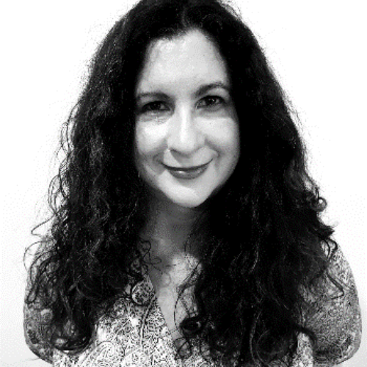
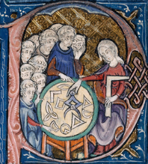
Geometric Science of Information (GSI'23) Saint-Malo, France, 30th Aug-1st Sept 2023 Keynote speaker: Eva MIRANDA
Polytechnic University of Catalonia
From Alan Turing to Contact geometry: towards a "Fluid computer”
Is hydrodynamics capable of performing computations? (Moore 1991). Can a mechanical system (including a fluid flow) simulate a universal Turing machine? (Tao, 2016). Etnyre and Ghrist unveiled a mirror between contact geometry and fluid dynamics reflecting Reeb vector fields as Beltrami vector fields. With the aid of this mirror, we can answer in the positive the questions raised by Moore and Tao. This is a recent result that mixes up techniques from Alan Turing with modern Geometry (contact geometry) to construct a "Fluid computer" in dimension 3. This construction shows, in particular, the existence of undecidable fluid paths. I will also explain applications of this mirror to the detection of escape trajectories in Celestial mechanics (for which I'll need to extend the mirror to a singular set-up). This mirror allows us to construct a tunnel connecting problems in Celestial mechanics and Fluid Dynamics.
Robert Cardona, Eva Miranda, Daniel Peralta-Salas, and Francisco Presas, Constructing Turing complete Euler flows in dimension 3. Proc. Natl. Acad. Sci. USA 118 (2021), no. 19, Paper No. e2026818118, 9 pp.
https://gsi2023.org/
2/n

Slide 5

Geometric Science of Information (GSI'23) Saint-Malo, France, 30th Aug-1st Sept 2023 Keynote speaker: Diarra FALL
Statistics Methods for Medical Image Processing and Reconstruction
In this talk we will see how statistical methods, from the simplest to the most advanced ones, can be used to address various problems in medical image processing and reconstruction for different imaging modalities. Image reconstruction allows to obtain the images in question, while image processing (on the already reconstructed images) aims at extracting some information of interest. We will review several statistical methods (mainely Bayesian) to address various problems of this type.
https://gsi2023.org/
Institut Denis Poisson, UMR CNRS
Université d'Orléans
& Université de Tours, France.
M.D. Fall, N. Dobigeon, P. Auzou, "A Bayesian Estimation Formulation to Voxel-Based Lesion Symptom Mapping", Proc. European Signal Processing Conf. (EUSIPCO), Belgrade, Serbia, Sept. 2022.
3/n

Slide 6
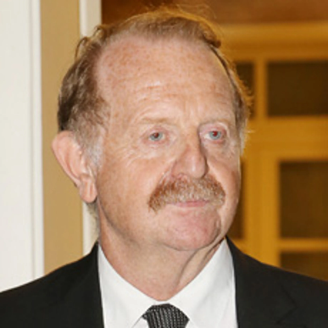

Geometric Science of Information (GSI'23) Saint-Malo, France, 30th Aug-1st Sept 2023 Keynote speaker: Hervé SABOURIN
Coadjoint Orbit Geometry & Transverse Structures
https://gsi2023.org/
Hervé SABOURIN
Poitiers University

Slide 7
Geometric Science of Information (GSI'23) Saint-Malo, France, 30th Aug-1st Sept 2023
Transverse Poisson Structures to adjoint orbits in a complex semi-simple Lie algebra
The notion of transverse Poisson structure has been introduced by Arthur Weinstein stating in his famous splitting theorem that any Poisson Manifold M is, in the neighbourhood of each point m, the product of a symplectic manifold, the symplectic leaf S at m, and a submanifold N which can be endowed with a structure of Poisson manifold of rank 0 at m. N is called a transverse slice at M of S. When M is the dual of a complex Lie algebra g equipped with its standard Lie-Poisson structure, we know that the symplectic leaf through x is the coadjoint G. x of the adjoint Lie group G of g. Moreover, there is a natural way to describe the transverse slice to the coadjoint orbit and, using a canonical system of linear coordinates (q1, ....., qk), it follows that the coefficients of the transverse Poisson structure are rational in (q1, ....., qk). continued on gsi2023.org
Hervé SABOURIN
Poitiers University
https://gsi2023.org/

Slide 8
Geometric Science of Information (GSI'23) Saint-Malo, France, 30th Aug-1st Sept 2023
Transverse Poisson Structures to adjoint orbits in a complex semi-simple Lie algebra
The notion of transverse Poisson structure has been introduced by Arthur Weinstein stating in his famous splitting theorem that any Poisson Manifold M is, in the neighbourhood of each point m, the product of a symplectic manifold, the symplectic leaf S at m, and a submanifold N which can be endowed with a structure of Poisson manifold of rank 0 at m. N is called a transverse slice at M of S. When M is the dual of a complex Lie algebra g equipped with its standard Lie-Poisson structure, we know that the symplectic leaf through x is the coadjoint G. x of the adjoint Lie group G of g. Moreover, there is a natural way to describe the transverse slice to the coadjoint orbit and, using a canonical system of linear coordinates (q1, ....., qk), it follows that the coefficients of the transverse Poisson structure are rational in (q1, ....., qk). continued on gsi2023.org
Hervé SABOURIN
Poitiers University
https://gsi2023.org/

Slide 9
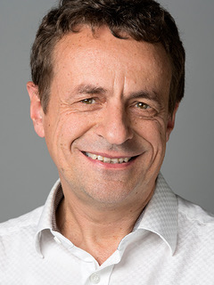
Geometric Science of Information (GSI'23) Saint-Malo, France, 30th Aug-1st Sept 2023
Algebraic Statistics and Gibbs Manifolds
Gibbs manifolds are images of affine spaces of symmetric matrices under the exponential map. They arise in applications such as optimization, statistics and quantum physics, where they extend the ubiquitous role of toric geometry. The Gibbs variety is the zero locus of all polynomials that vanish on the Gibbs manifold. This lecture gives an introduction to these objects from the perspective of Algebraic Statistics.
https://gsi2023.org/
Bernd STURMFELS
MPI-MiS Leipzig
Germany

Slide 10
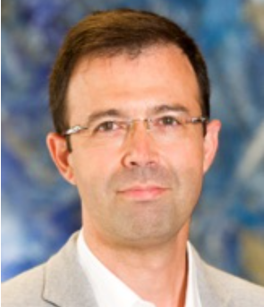
Geometric Science of Information (GSI'23) Saint-Malo, France, 30th Aug-1st Sept 2023
Learning of Dynamic Processes
The last decade has seen the emergence of learning techniques that use the computational power of dynamical systems for information processing. Some of those paradigms are based on architectures that are partially randomly generated and require a relatively cheap training effort, which makes them ideal in many applications. The need for a mathematical understanding of the working principles underlying this approach, collectively known as Reservoir Computing, has led to the construction of new techniques that put together well-known results in systems theory and dynamics with others coming from approximation and statistical learning theory. This combination has allowed in recent times to elevate Reservoir Computing to the realm of provable machine learning paradigms and, as we will see in this talk, it also hints at various connections with kernel maps, structure-preserving algorithms, and physics-inspired learning.
https://gsi2023.org/
Juan-Pablo ORTEGA
Nanyang Technological
University, Singapore

Slide 11


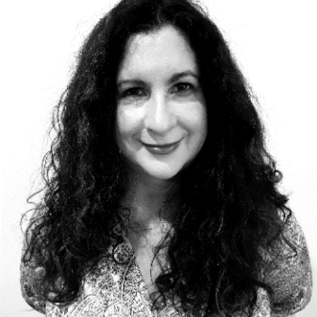


https://franknielsen.github.io/GSI/
Eva Miranda
Polytechnic University of Catalonia, Spain
From Alan Turing to Contact geometry:
towards a "Fluid computer”
Francis BACH
Inria, Ecole Normale Supérieure, France
Information Theory with Kernel Methods
Bernd STURMFELS
MPI-MiS Leipzig Germany
Algebraic Statistics and Gibbs Manifolds
Diarra FALL
Institut Denis Poisson, Université d'Orléans & Université de Tours, France
Statistics Methods for Medical Image Processing and Reconstruction
Hervé SABOURIN
Poitiers University, France
Transverse Poisson Structures to adjoint
orbits in a complex semi-simple Lie algebra
Juan-Pablo ORTEGA
Nanyang Technological University, Singapore
Learning of Dynamic Processes
Random ordering of keynote speakers

Slide 12
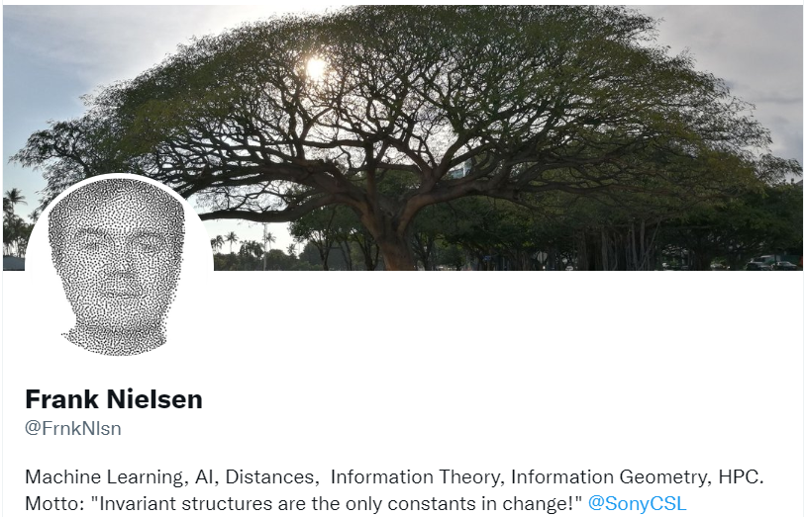
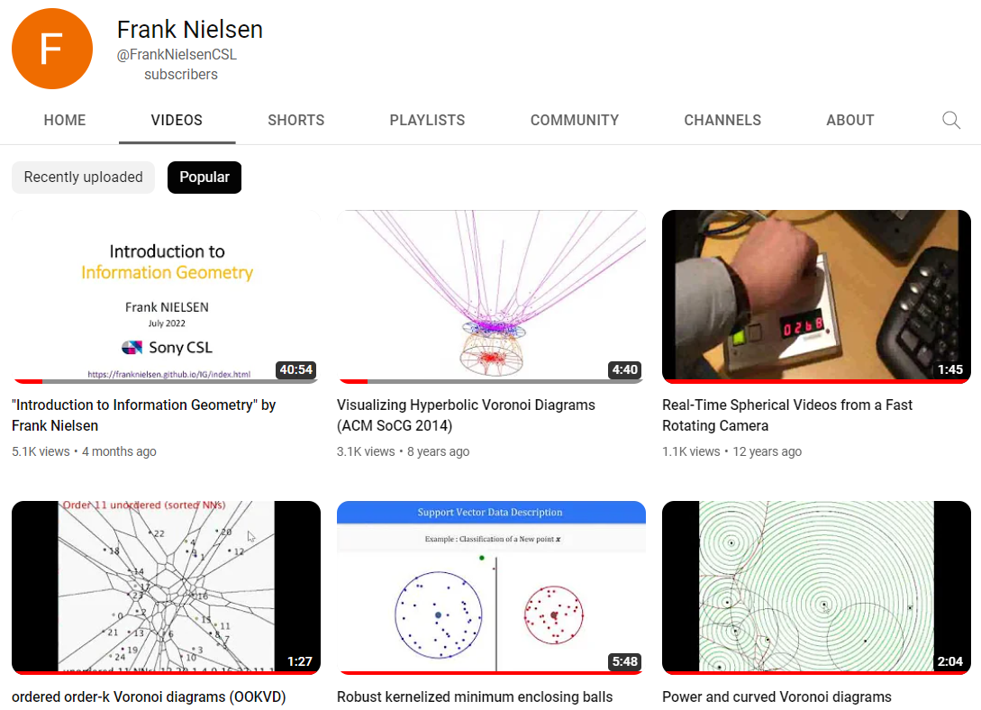



Slide 14


Slide 15
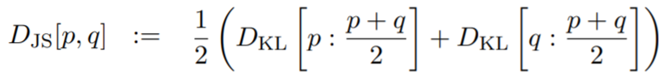
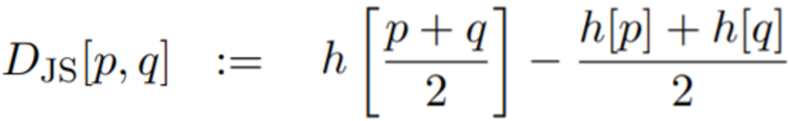
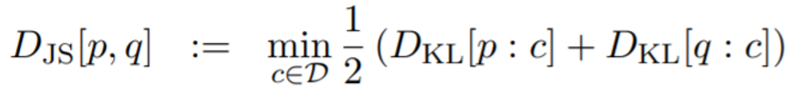
Three faces of the Jensen-Shannon divergence (JSD) ... yielding three different generalizations
JSD is a symmetrization of the Kullback-Leibler divergence:
→ Replace arithmetic mixture by geometric mixture, get geometric JSD
JSD is the entropy of the average distribution minus the average of the distribution entropies:
→ Jensen-Shannon centroid posed as a Difference of Convex program, solved using Convex-ConCave Procedure (CCCP)
JSD is Bregman information with respect to the centroid:
→ Replace arithmetic average by Rény α-means and get Sibson's α-information radius
Notes:
Three faces of the Jensen-Shannon divergence (JSD) yielding three different generalizations:
1/ Symmetrization of the KLD using means generalizing the arithmetic mixture
2/ Replacing concave Shannon entropy by other concave entropies
3/ Replacing minimization of the average KLD by minimization of other KLD means

Slide 17

From Alan Turing to Contact geometry: towards a "Fluid computer"

